Slide 1
Solution for effective utilization of coir raw material to avoid wastage
PIP2001 Capstone Project
Review-0
Batch Number: CST-G18
Under the Supervision of,
Mrs. Shaik Salma Begum
Professor
School of Computer Science and Engineering
Presidency University
Roll Number | Student Name
20211CST0006 | Nagaruru Sunandhan
20211CST0039 | Bobbiti Yaswanth Reddy
20211CST0041 | Kruthika S
Name of the Program: BTech
Name of the HoD: Dr. Saira Banu
Name of the Program Project Coordinator: Dr. H M Manjula
Name of the School Project Coordinators: Dr. Abdul Khadar A

Slide 2
Content
Problem Statement
Github Link
Analysis of Problem Statement
Timeline of the Project
References

Slide 3
Problem Statement Number: PSCS202
Organization: MSME-DI CHENNAI
Category : Software
Problem Description:
Our solution to the problem is to provide a web platform for the industry personnel to get real time information about the availability and amount of the raw materials they want. The industries, farmers and data analytical firms should register with valid id proofs to ensure transparency in the system. The coconut farm owners should provide the data about the raw materials available which would be stored in the database. Farmer can add new data and update it according to availability. This can be done by web login as well as through SMS system. Transaction details will be saved as soon as industry owner completes the transaction. Data Analytical firms can have the transaction details in a well ordered manner for various surveys.
Difficulty Level: Simple

Slide 4
Github Link
Repository : Effective-utilization-of-coir-raw-material-to-avoid-wastage
Github Link
https://github.com/nanda898/Effective-utilization-of-coir-raw-material-to-avoid-wastage

Slide 5
Analysis of Problem Statement
Technology Stack Components:
Frontend: HTML, CSS, JavaScript, Bootstrap.
Backend: Django, Python.
Database: SQLite (default), PostgreSQL/MySQL (optional).
User Authentication: Django Authentication System.
SMS API: Twilio/Vonage Messages API.
Version Control: Git and GitHub.

Slide 6
Analysis of Problem Statement (contd...)
Software Requirements:
IDE : VS code
Django
MySQL
Version Control : Git

Slide 7
Analysis of Problem Statement (contd...)
Objective:
1. Efficient Resource Management: Provide a platform for industries and farmers to access real-time information on coir raw material availability, minimizing wastage.
2. Transparency and Trust: Ensure transparency in transactions by requiring valid ID proofs for registration and tracking all transactions through a secure system.
Features:
1. User Registration & Login: Farmers, industries, and data analytics firms register with valid IDs for secure access and role-based permissions.
2. Real-Time Data Updates: Farmers can update stock availability via the web or SMS, ensuring accurate and up-to-date information for buyers.

Slide 8
Analysis of Problem Statement (contd...)
Benefits:
1. Enhanced Market Reach: Farmers can list their coir raw materials on the website, expanding their reach to potential buyers and increasing sales opportunities.
2. Reduced Wastage: Real-time material updates prevent overstocking and under-utilization of coir raw materials, enhancing resource efficiency.
3. Data-Driven Decisions: Analytical firms can access well-organized data for surveys, helping industries optimize raw material usage and forecast demand effectively.

Slide 9
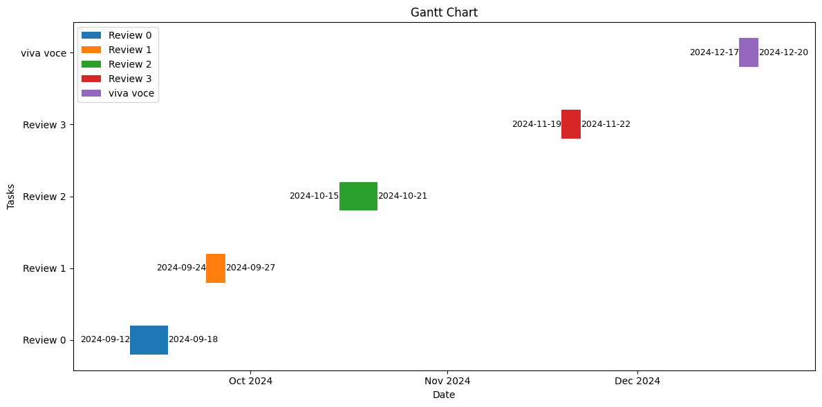
Timeline of the Project (Gantt Chart)

Slide 10
References (IEEE Paper format)
https://www.researchgate.net/publication/365419789_Coir_from_coconut_processing_waste_as_a_raw_material_for_applications_beyond_traditional_uses
https://www.sciencedirect.com/science/article/abs/pii/S0950061822022632

Slide 11


